Slide 1

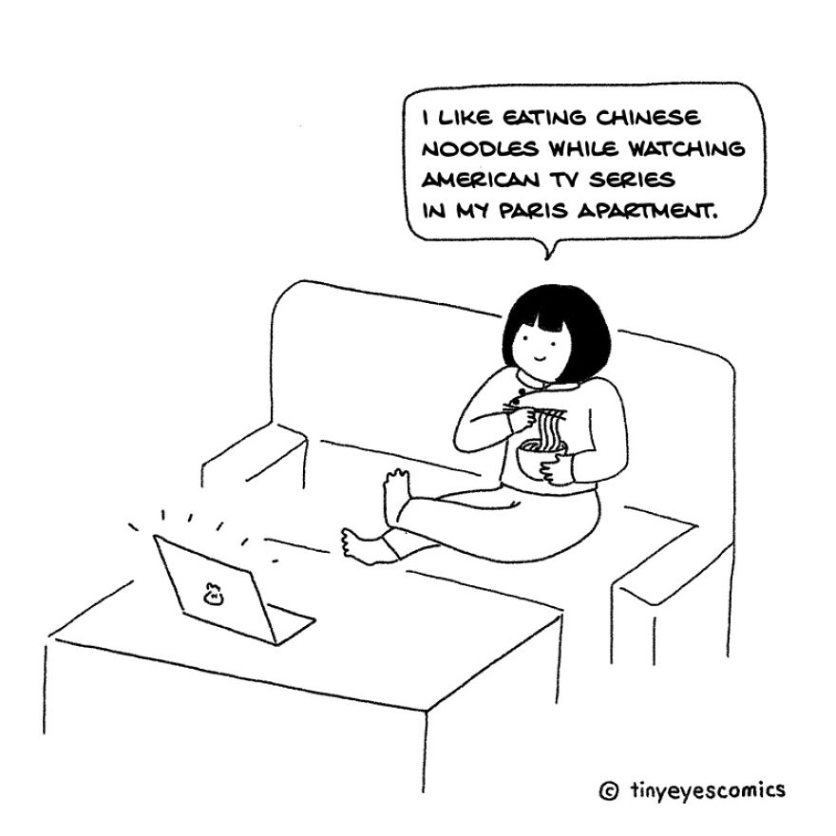

MULTICULTURAL CONFLICT

Slide 2
MULTICULTURAL CONFLICT
Conflict that arises between people or social groups that are divided by cultural barriers can be referred to as "cross-cultural conflict".
However, people can belong to a variety of groups, even within the same society, based on a variety of factors, such as kinship into families or clans, language, religion, ethnicity, or nationality; socioeconomic status, social classes; geographic location, political interest groups; or institutional memberships, professions, trade unions, organisations and industries.
Potential groups increase in number as a society becomes more complex and diverse. Each of these groups is a possible "container" for culture, therefore any complex society is likely to consist of a variety of "subcultures," or people who are themselves "multicultural" due to their participation in many, overlapping groups. This implies that conflicts across cultural boundaries may take place concurrently at several levels.

Slide 3
SOURCES OF MULTICULTURAL CONFLICT
Seeing as people from various cultures have distinct cultural values, thoughts, traditions, etc., there are obstacles that prevent successful communication. A barrier due to culture can be:
Language
Social values
Traditions
Beliefs and values
Ethnic background
Religion
Politics

Slide 4
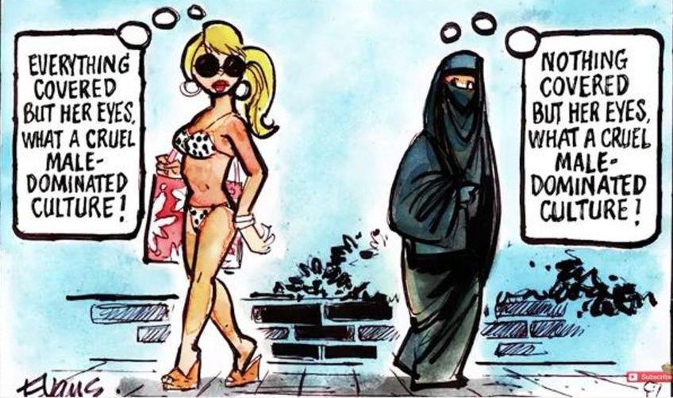
ETHNOCENTRISM
Ethnocentrism is the most frequent cause of multicultural conflict.
Ethnocentrism ultimately results from a person's conviction that their culture and way of life are correct. Although there are many varying levels of ethnocentrism, someone who is extremely ethnocentric would see the world as they have experienced it.
Any alternative world is invisible to them.
A person who holds this extreme viewpoint will not understand that they are products of culture; everyone else has a culture, but they do not. They do things correctly, whilst everyone else does them incorrectly.

Slide 5
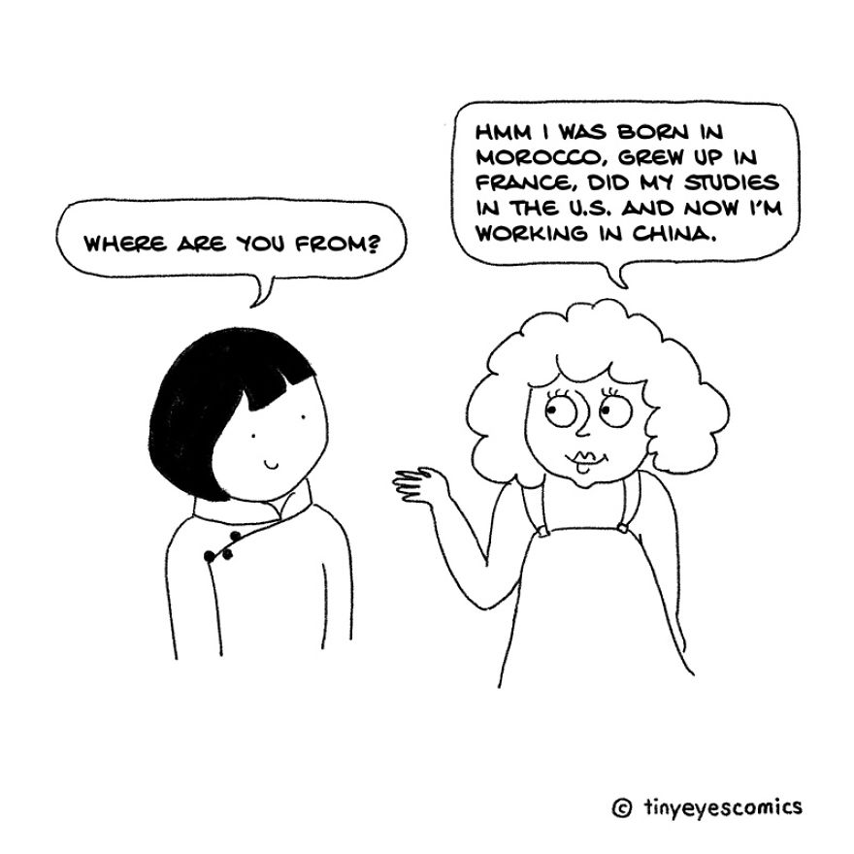
LACK OF CULTURAL AWARENESS
Cultural misunderstanding occurs when people from different cultures interpret situations differently.
Misunderstanding is a normal part of an interpersonal conflict.
The way we perceive and interpret what is happening around us depends on our beliefs and values, which are influenced by our language, culture, and cultural background.
When we are with people who share the same language, culture, and background, there is a good chance that we can communicate easily and get along well. But when someone comes from a different culture, we may have difficulty understanding or being understood by them.

Slide 6
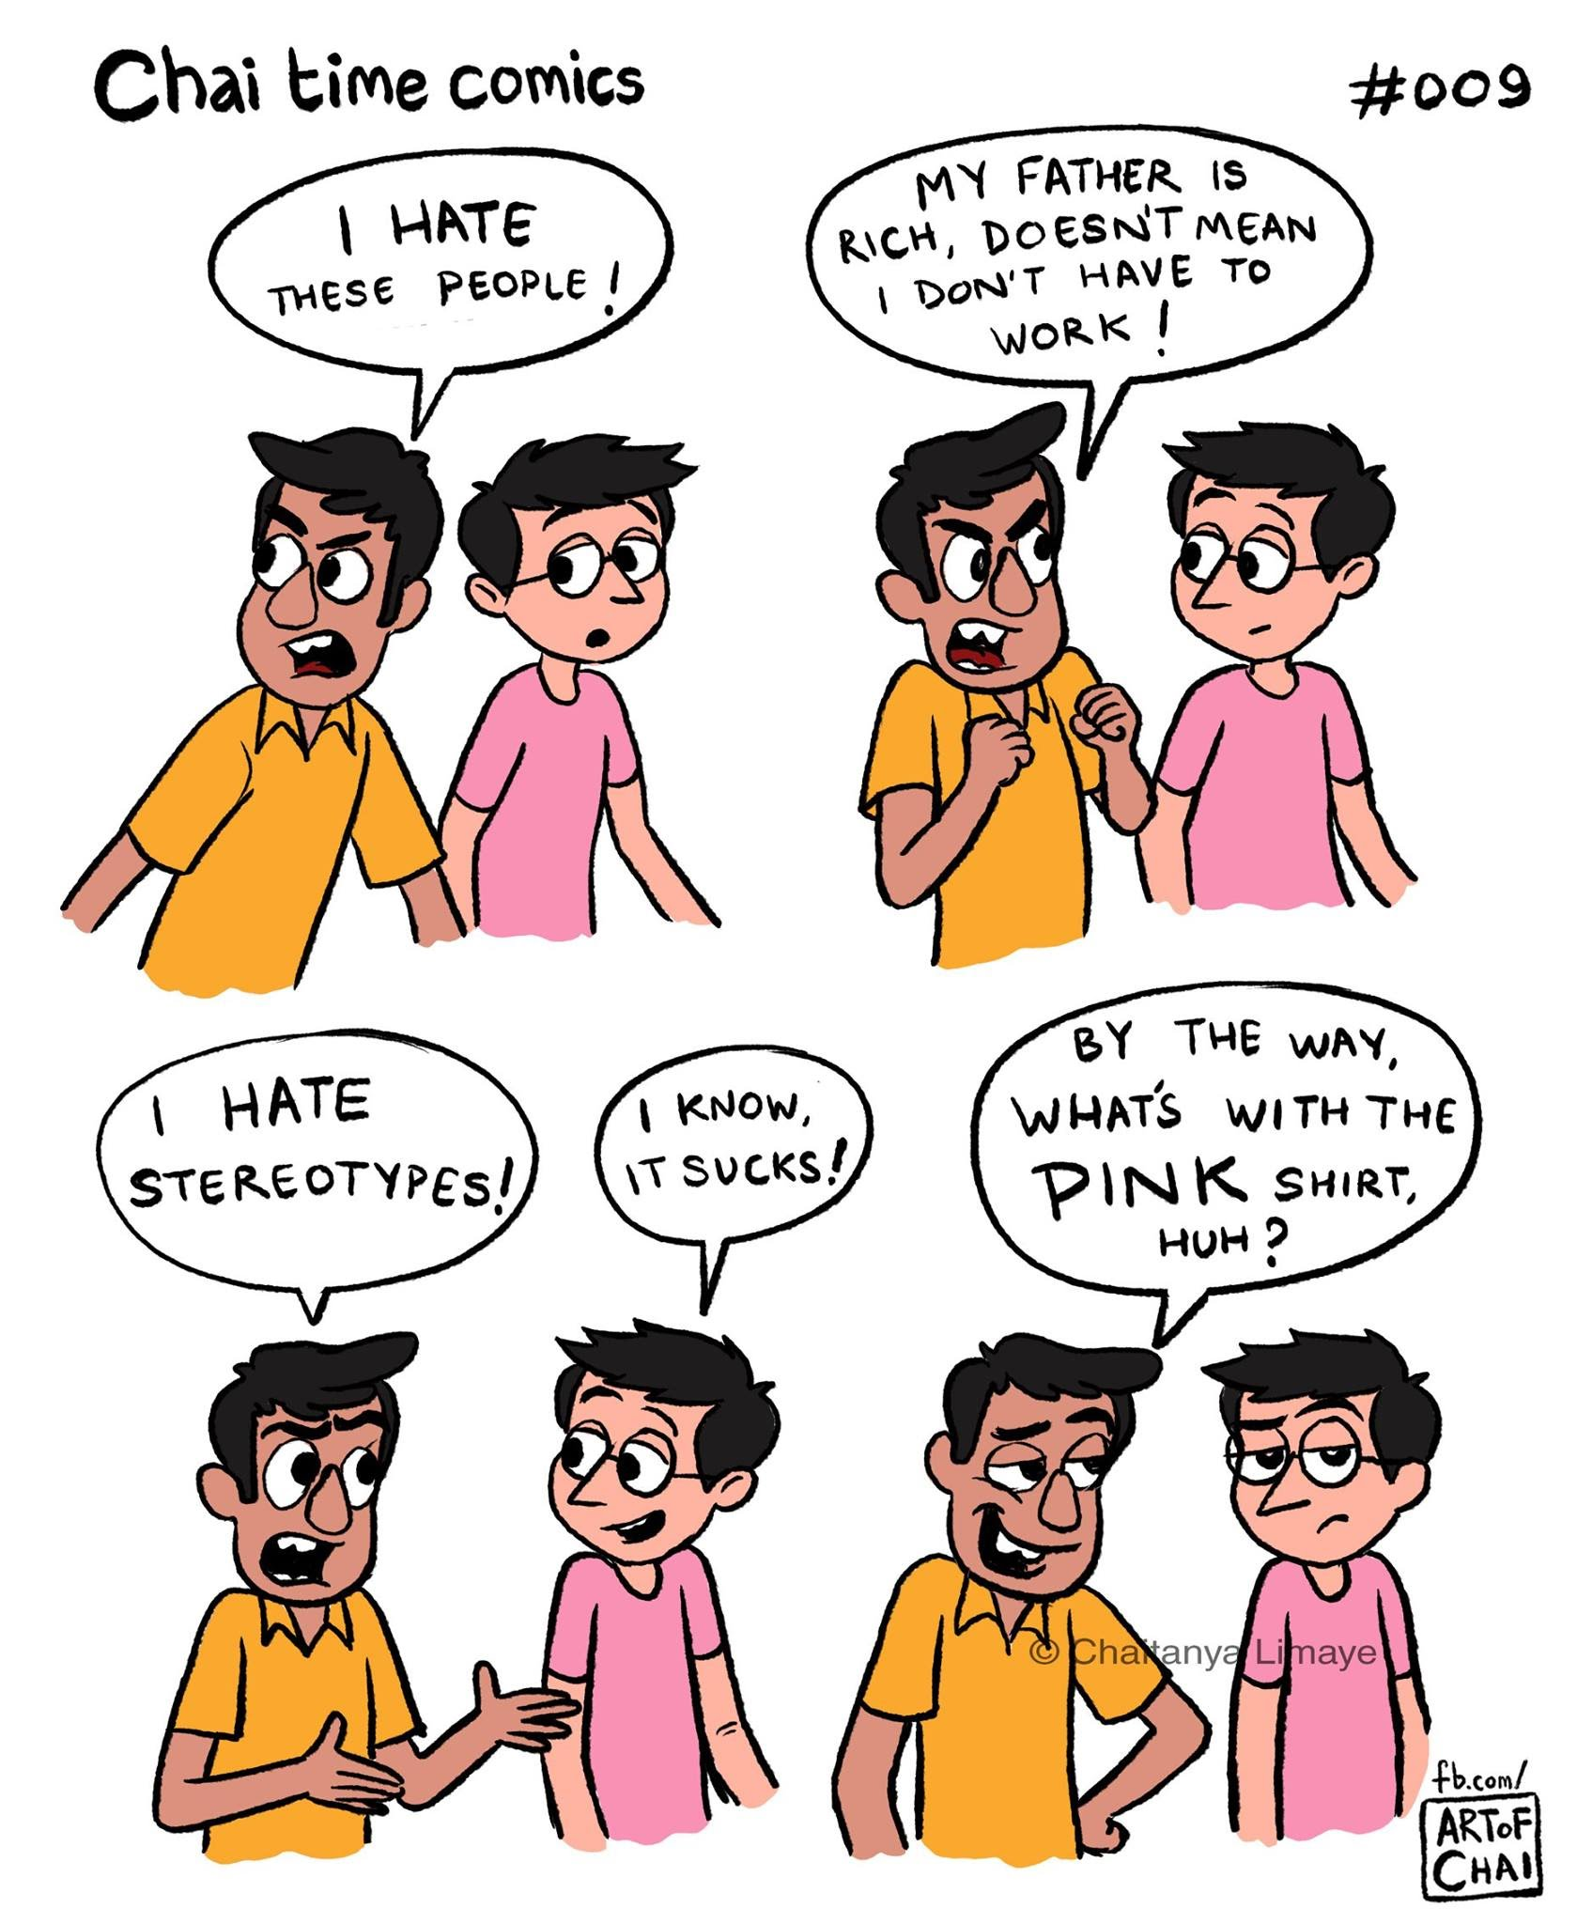
STEREOTYPES
Stereotypes are simplifications of reality. They reduce people and cultures to a few familiar characteristics and ignore their rich diversity. Even if they are shared by a large number of people, they do not reflect reality.

Slide 7
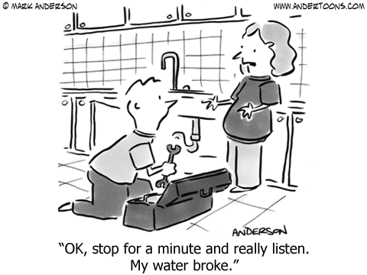
COMMUNICATION STYLE
In our daily lives, communication is crucial. Nonetheless, there are occasions when we are unable to converse with others because of the differences in their beliefs and culture. Training in effective communication can improve our understanding of people and their true nature.
To be effective in your relationship with others, you must choose the appropriate means of communication. Everyone needs to be aware of and embrace the fact that there are several cultures across the world, and each one has a unique communication style that differs from your own.

Slide 8
NON VERBAL COMMUNICATION
Nonverbal Communication - In order to effectively communicate with someone, you must use both words and nonverbal cues.
Nonverbal communication has different levels of significance and varies from culture to culture. Making eye contact or smiling may be viewed as impolite in some cultures. Always be mindful of the cultural background of your adversary.
Although while nonverbal communication has a lot to say at once, it can be challenging to understand if you are not aware of the cultural background. It's critical to understand that different cultures and regions of the world assign different meanings to specific gestures.

Slide 9
BODY LANGUAGE
Body language is one of the most important components of nonverbal communication. It can convey many emotions at once: Joy, anger, disappointment, etc., but also underline and confirm what we say verbally.
People often believe that they can read other people’s body language well and that they themselves do not send misleading signals. However, it is not always easy to interpret body language correctly, and it is even more difficult to ensure that others interpret our body language as we intend.
Nonverbal communication is not only about how you use your body, but also about how you are dressed, the tone of voice you use, and much more.

Slide 10
HANDSHAKE MEANING ACROSS CULTURES
Even the handshake might differ from one culture to another. The standard greeting is a handshake, however depending on where you are, you may need to modify the hardness.
In contrast to many regions of the Far East, where a firm handshake is frequently seen as hostile, Western cultures normally view a firm handshake as authoritative and confident.
An instantaneous, forceful handshake is customary in several regions of Northern Europe. The handshake is lengthier and warmer in regions of Southern Europe, Central America, and South America, and the left hand generally touches the clasped hands or elbow.
Be aware that a forceful handshake is frowned upon and seen as pushy in Turkey. The custom in several African nations is to shake hands slowly (Guide to African handshakes). Islamic nations prohibit males from shaking women's hands when they are not family members.

Slide 11
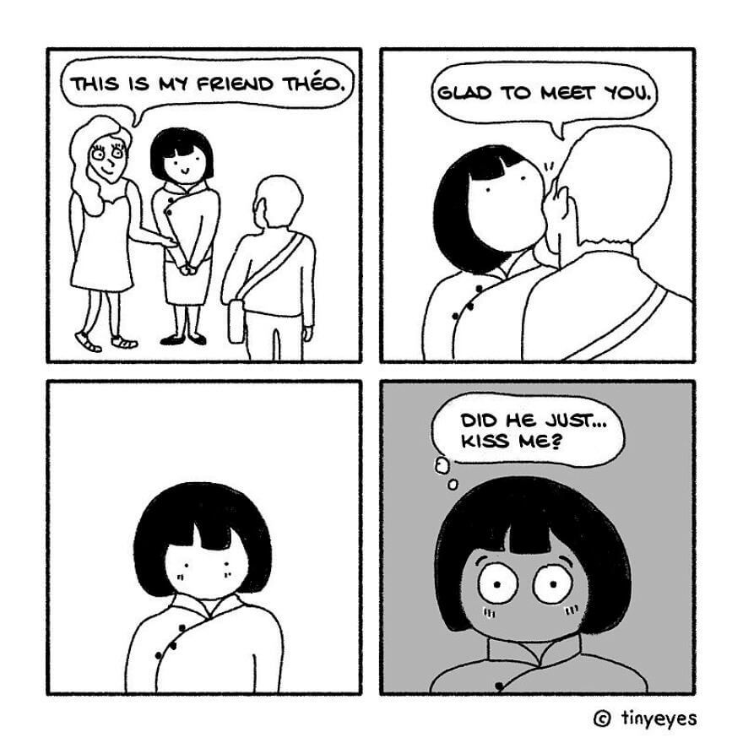
GENDER
What is appropriate for a male may not be acceptable for a woman in different cultures. The subject of wearing a head covering in some Muslim nations is the most prominent example, but other religions, including Islam and Hinduism, also have laws against shaking a woman's hand.

Slide 12
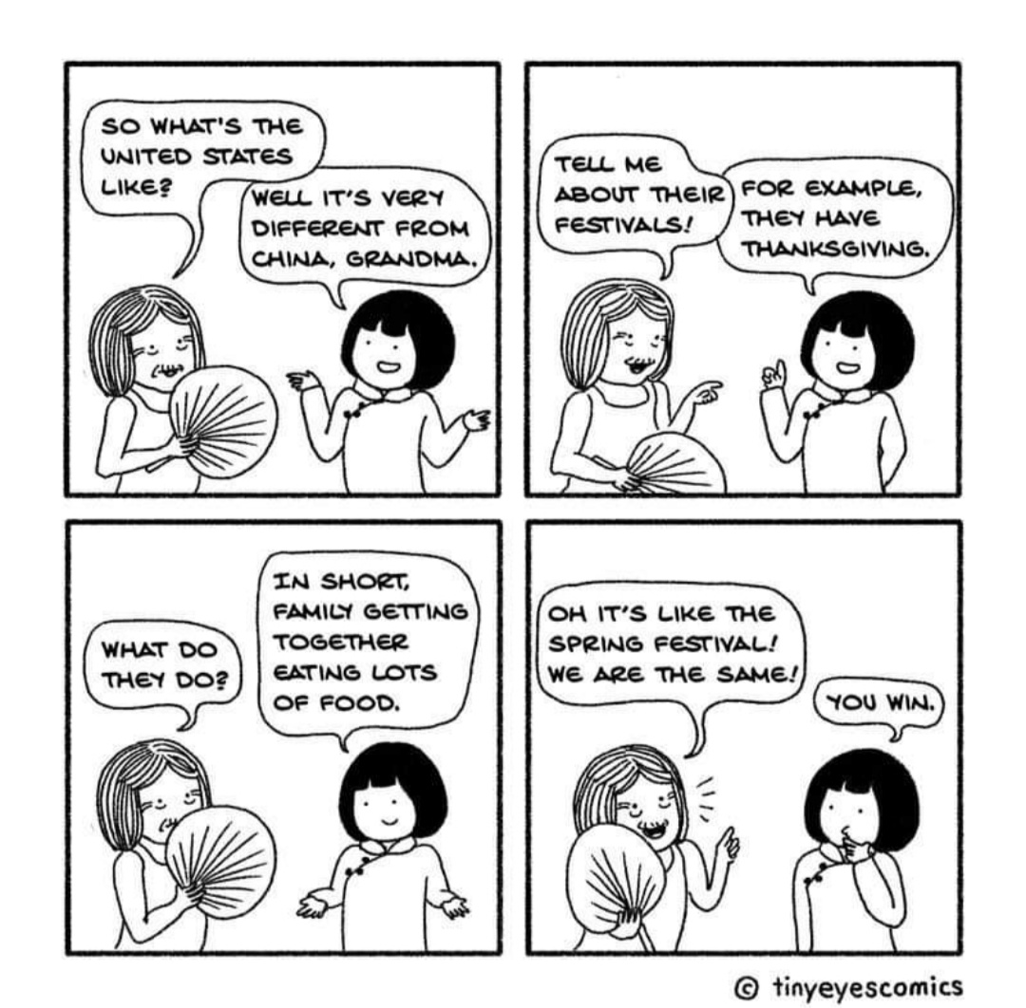
MULTICULTURAL CONFLICT IN RELATIONSHIPS
Multicultural partnerships can provide extra difficulties such as conflicting religious views, a sense of identity loss, and diverse parenting styles in addition to the tensions and strains that impact all parents. The things that might strain your relationship can be difficult to adapt to or adjust to.
Parents of mixed-culture families must make accommodations for the other person's culture. Moreover, pressure from the extended family may exist and have an impact on parents' choices. Parents who take our course are given the tools to consider what they can add to the family, what can be shared in celebration, and what can be left behind.

Slide 13
MULTICULTURAL CONFLICT IN MARRIAGES
The special difficulty of communicating their emotions and thoughts to a spouse from a radically different background faces intercultural couples. Partners have intense affection for their wives because of the closeness of their connection, which can make interactions and communication more difficult (Foeman & Nance, 1999).
The intersubjectivity hypothesis identifies a further cause of conflict in multicultural relationships (Waldman & Rubalcava, 2005). According to this idea, people interpret their experiences based on their interpersonal interactions and individual interpretations. The influence that culture has on a couple's ideas, feelings, and behaviour is frequently unnoticed by them.
People are influenced by culture in such a way that they think their own culture is right and the greatest way to live. Similarly, partners believe that their perceptions of their partners' activities are factual and correct (Waldman & Rubalcava, 2005). Both impressions have the potential to result in bitter conflict and make it difficult to settle disputes amicably.

Slide 14
MULTICULTURAL CONFLICT IN MARRIAGES
Some possible problem areas for international marriages have been discovered by researchers. Eight key areas where multicultural couples face special difficulties were identified by Cools' (2006) study: language, communication, adjusting to a spouse, friends, raising children, gender roles, visibility, and traditions.
The most often stated topics were visibility and gender roles. Similar findings were obtained in the studies of gender, language, and childrearing by Frame (2004). In multicultural marriages, there was also the possibility for heightened conflict over values, money, sexuality, religion, and social status.
Garcia (2006) argued that multicultural couples may experience more challenges while trying to raise children. Intercultural marriages are fraught with a variety of problems. These topics are prone to misconceptions, which can result in bitter confrontation. If seen negatively and left unaddressed, differences between spouses have a detrimental effect on the marriage (Mackey, Diemer, & O'Brien, 2000).

Slide 15
MULTICULTURAL CONFLICT IN MARRIAGES
For couples in multicultural marriages, difficulties in arriving at practical solutions might stem from their failure to completely comprehend an understanding of the dispute as well as put what they want to say into clear language (Frame, 2004).
These particular relationships may give rise to unusual and complicated problems. Although being ethereal, values are transmitted and shown in very concrete ways.
Intercultural couples may have quite different value systems as a result of their varied upbringings, which increases the likelihood of disagreement and conflict. Values influence belief structures and worldviews, which in turn influence attitudes and actions.

Slide 16
MULTICULTURAL CONFLICT IN FAMILIES
Parents frequently feel a connection to their culture and customs, parents frequently disagree about who will dominate the child's development and how their children should be nurtured.
Conflicts can be found in mixed-ethnicity families with an Afro-Caribbean parent around the upkeep of the child's hair. When the parents don't live together, this might lead to even more disputes.
Different cultures might have distinct routines, habits, and beliefs. Some cultures may be stricter than others or prioritise different things, which can lead to disagreements between parents concerning discipline. These disagreements can have an impact on the children and, as a result of contradictory expectations, can lead to low self-esteem in children within the family.

Slide 17
EXTENDED FAMILY
You may have only ever seen your grandparents twice a year, but your foreign-born husband may come from a huge extended family where everyone is involved in caring for the newborn.
For people who come from homes or cultures where responsibilities and personal limits are defined quite differently, certain encounters may feel intrusive.
Be prepared to be more understanding than you may be in a marriage between people of the same culture by learning about the family structure and manners of your own spouse's culture and upbringing.

Slide 18
EXTENDED FAMILY
Different cultures will have different prospect of extended visits from relatives which can lead to conflict within multicultural marriages. While visiting from abroad or another city, in-laws may plan to remain for several months.
Moreover, if you wind up relocating to your foreign spouse's place of origin, you can discover that local family members not only surprise you with unannounced visits but also by remaining for many days.
Regular or prolonged visits from family members might become draining and annoying depending on the hospitality customs of your spouse's culture, especially if communication is challenging.

Slide 19
PARENTING STYLES IN
A MULTICULTURAL FAMILY
Even spouses from the same cultural background may disagree on issues like bedtime rituals, punishment methods, and snack choices. Yet, there are additional concerns when it comes to raising children in cross-cultural relationships, and the decision of whether or not to raise multilingual children is only one of them.
Regarding expressing affection, caving to children's whims, family engagement, proper gender play and roles, behavioural and academic expectations, and other topics, social standards differ considerably throughout the world.
It will be beneficial if you make an upfront commitment to respect one other's individual parenting approaches and to be amenable to compromise when you do discover that you have quite different points of view.

Slide 20
PLACE OF RESIDENCE
Whilst it may seem exotic and appealing to live overseas, the reality might not be so ideal, particularly if you choose to settle in a less developed region of the world. An expatriate may feel overwhelmed by a different language, distance from their own family, frequent misunderstandings with in-laws, and making new friends.
Losing one's freedom after moving to a foreign nation may also be a result of language barriers, cultural misunderstandings, or even an overly protective spouse. Someone who is accustomed to moving about freely and decisively may find this to be particularly difficult.
While these concerns can seem unimportant or far away when a couple is first married, the probability of moving overseas may rise over time.
For instance, if you have children, your partner who was born abroad can feel that "home" is a superior setting. Or perhaps you and your partner decide to fully immerse the kids in the other culture.

Slide 21
RELIGION
Religious doctrine plays a significant role in the forms of families, divorce, and child custody arrangements. Islam allows polygamous weddings but Christianity exclusively recognises monogamous unions.
While the Orthodox church allows three divorces and the Protestant faiths allow divorce, the Catholic church does not. There are several additional instances of how religion influences different family forms in different countries.
For example in Islam The Qur'an promotes reconciliation, through negotiated settlements between the spouses themselves or the use of arbitrators from their families. However, when “mutual good treatment” is not possible, there should be an amicable parting. Thus, the Qur'an treats divorce as something permitted but not laudable.
However, according to sharia law, there are two reasons a wife may be granted divorce: When she can prove that the husband did not have intercourse with her or more than three months or if the husband does not provide her with what she needs for living such as food and shelter.

Slide 22
CULTURAL VARIABILITY
Individualism/collectivism, power distance, uncertainty avoidance, masculinity/femininity, and short/long-term orientation are among Hofstede's (2001) five aspects of cultural variety.
People have a higher chance to participate in intercultural dialogue that results in conflict resolution by recognising and comprehending these specific broad cultural trends.
According to Oetzel et al. (2007), the concepts of individuality, collectivism, and power distance are most frequently used to explain multicultural conflict. They contend that conflict styles may be handled and created in a way that incorporates culture into the description and comprehension of these styles.

Slide 23
CONFLICT RESOLUTION TYPES
There are two main methods for resolving conflicts:
Judicial dispute resolution
Lawsuits (litigation)
Arbitration
Judicial: litigation or arbitration in which the result is determined by a court.
Conflicts can be settled through the legal system. Many people seek a skilled advocate to defend them in court because certain disagreements cannot be resolved through mediation.
Litigation is the most frequent method of resolving legal disputes. When one side files a lawsuit against another, litigation begins. The supreme, high, circuit, and district courts of Ireland serve to assist litigation.
In place of court proceedings to resolve a disagreement, arbitration uses a private tribunal. The employment of arbitrators is established by law in some countries, and the parties are required to abide by the arbitrator's ruling. An arbitrator adjudicates the matter and may select a middle ground between the parties' final submissions.
Extrajudicial: negotiation, mediation, conciliation, or collaborative law.

Slide 24
EXTRAJUDICIAL CONFLICT RESOLUTION
Alternative Dispute Resolution (ADR)
Mediation
Negotiation
Conflict that is settled "via extrajudicial methods such as collaborative law, and mediation" is referred to as "alternative dispute resolution". It is used to settle conflict and potential conflict among people, businesses, governmental organisations, and nations.
The word "mediation" refers to a procedure when two or more parties appoint a neutral third party (a "Mediator") to assist them in a non-binding conversation to resolve a disagreement and to establish the parameters of an agreement.
The process of settling a disagreement through negotiation. It is meant to "resolve disagreements, develop a course of action agreement, negotiate for personal or group benefit, or construct results to fulfil multiple interests. It serves as the main alternative conflict settlement technique.

Slide 25
EXTRAJUDICIAL CONFLICT RESOLUTION
Collaborative Law
Conciliation
Collaborative Law, also known as Collaborative Practice, Collaborative Divorce, and Collaborative Family Law, is a process that enables individuals who have decided to separate or end their marriage to work with their solicitors and other family professionals, to avoid the outcome of a court settlement. When a couple signs a document (the Participation Agreement) they commit themselves to the process.
Conciliation is a dispute-resolution process where a conciliator is chosen and talks with each party separately. The primary difference between conciliation and mediation is that conciliators have specialised understanding of the dispute and are permitted to offer counsel to the parties..

Slide 26
MULTICULTURAL CONFLICT RESOLUTION
Cultural conflict has three dimensions. To the two dimensions that every conflict has (content and relational), cultural conflict adds the third one – ‘a clash of cultural values’. This third dimension constitutes the foundation of the conflict since it determines personal identity.
The resolution of cross-cultural conflict begins with identifying whether cultural issues are involved. There are three ways of cross-cultural conflict resolution.

Slide 27
PROBING FOR THE CULTURAL DIMENSION
The parties' recognition that their disagreement has a cultural component should serve as the starting point for the resolution process. The willingness of all parties to address all conflict aspects, including the cultural one, should come next. Finally, there has to be methodical, incremental work on the dispute.
In order to grasp the other party's cultural perspectives, the parties first express what they find offensive in each other's conduct. Next, they study how the problem would be handled in the other party's culture, and finally, they establish conflict resolution strategies. If the disagreement resulted from ideals that were irreconcilable rather than merely a misinterpretation of the other party's actions, it is very difficult to resolve.

Slide 28
LEARNING ABOUT OTHER CULTURES
By being more aware of the cultures they encounter, individuals might reduce the likelihood of intercultural disputes. Training programmes, general reading, conversations with individuals from many cultures, and taking lessons from the past are all ways to acquire this information.
Understanding your own culture and cultivating cultural awareness by learning about other cultures' values and beliefs without using cultural stereotypes are important components of cultural education.

Slide 29
ALTERING ORGANISATIONAL PROCEDURES
Frequently, the organisational structure inherits the cultural conflict and represents the norms of just one culture. In such circumstances, structural change is required to make the system more receptive to other people's cultural norms.
It is important to take into account the cultures and identifies that are a part of your organisation to avoid staff and management conflicts.

Slide 30
BIBLIOGRAPHY
https://www.beyondintractability.org/artsum/williams-resolving
https://brilliantio.com/what-is-the-best-way-to-manage-conflicts-based-on-cultural-differences/
https://www.nottingham.ac.uk/research/groups/ctccs/projects/translating-cultures/documents/journals/cross-cultural-conflict.pdf
https://tavistockrelationships.org/blogs-and-resources?view=article&id=1980&catid=43
https://tasteofmaroc.com/cross-cultural-marriage-issues/
https://scholarworks.gvsu.edu/cgi/viewcontent.cgi?article=1061&context=orpc
https://digitalcommons.liberty.edu/cgi/viewcontent.cgi?article=1206&context=masters
https://virtualspeech.com/blog/cultural-differences-in-body-language

