Slide 1
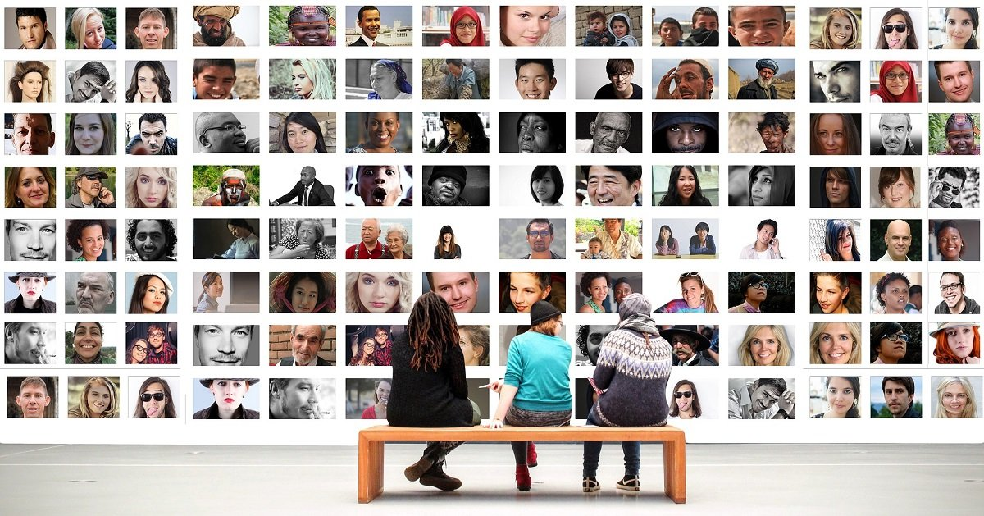


MULTICULTURAL MEDIATION TYPES

Slide 2
PEER MEDIATION: EDUCATIONAL SETTING
Peer mediation is when a young person receives mediation training, often in an educational context, and then resolves disputes between two other young people, sometimes at breaks and during lunch. Peer mediators typically settle disputes for other children and adolescents who are their own age or younger.
The purpose of peer mediation is to help children find appropriate ways to respond to problems with others, it is not about telling others what to do. Peer mediators do not "make decisions" but rather work towards a win-win resolution for both sides in order to avoid further conflict.

Slide 3
PEER MEDIATION: EDUCATIONAL SETTING
The children learn:
How to interact with their peers in a positive, cooperative way.
How to be neutral
and fair.
To improve their
self-esteem
How to understand conflict and what it means.
To accept accountability for their own actions.
To enhance their capacity for communicating with others and oneself
To improve their listening skills

Slide 4




PEER MEDIATION IN CASTLEREA PRISON, IRELAND
Prior to the implementation of mediation in Castlerea, inmate-on-inmate and inmate-on-staff violence was not uncommon, with some of these disputes starting when the people in prison had been in the community. Although some people believed that violence was necessary to resolve disputes, in most cases it just served to escalate and prolong the fight.
Teachers, Red Cross volunteers, and other partners, such as the Traveller Mediation Service and the Travellers in Prison Initiative, have already participated in conflict awareness courses in Castlerea.
Prison administrators eagerly backed these courses because they believed that they soon reduced assaults.
More than 200 people in Castlerea had participated as of March 2020. Early on in the course, student input led to the conception of teaching mediation skills within the prison.

Slide 5
PEER MEDIATION IN CASTLEREA PRISON, IRELAND
The efficacy of the programme was credited in large part to the key role played by Travellers, particularly Traveller women who have been delivering the training, as well as to the assistance and oversight provided by prison teaching personnel.
The most recent curriculum, which sought to qualify students for MII accreditation, was created in cooperation with the Traveller Mediation Service, the Education and Training Board (ETB) inside the prison, and the Edward Kennedy Centre for Conflict Intervention at Maynooth University.
The training was delivered over twelve weeks in 2019 for two half-days each week. One session every week concentrated on theories and procedures, while the other one concentrated on role plays and skill development.
This course was taken by nine persons, including two teachers and the four detained Travelers. Eight achieved complete MII accreditation by passing both the written and practical exams. For all of the participants in this curriculum, it was the greatest degree of education they had ever acquired and marked a first for Ireland.

Slide 6
PEER MEDIATION IN CASTLEREA PRISON, IRELAND
The degree of cultural change among inmates, staff, and participants in Castlerea has astounded those involved. Managers, employees, and those in prison now trust and believe in mediation since there is less violence. The initial goal was not to launch a project for mediation but rather to work with the ETB and Red Cross to lessen violence.
Yet, as everyone involved in the process worked together to advance the work, what began as conflict awareness developed into conflict resolution, continued as peer mediation, and finally resulted in certified mediators effectively working in Castlerea.
Several managers from Castlerea also earned their certification as mediators, joining a network of staff mediators across the Irish Prison Service and improving their capacity to assist peer mediation in Castlerea on an operational level.

Slide 7
REFUGEE AND MIGRANT
PEER MEDIATION
Those who reside in refugee shelters and multi occupancy housing usually deal with an atmosphere that serves as a fertile basis for interpersonal conflict.
Living in close quarters, sharing resources with people from different backgrounds, language barriers, psychological trauma, lack of daily structure, inadequate growth perspectives, unfamiliarity with other cultures, different religions, existential fears, and pre-existing ethnic tensions are all factors that reinforce and sustain a wide variety of conflicts (Plich, 2016a).
Daily disagreements amongst the locals themselves or with inhabitants of nearby communities are therefore common (Bauer, 2017).
Disputes within shelters frequently centre on matters like noncompliance to the rules, drug and alcohol abuse, eating and drinking habits, hygiene, loudness, and the usage of communal spaces.

Slide 8
REFUGEE AND MIGRANT
PEER MEDIATION
The difficulty of moving to and settling in a new country has been referred to as the post-migratory "third hit" of sequential traumatization in the context of psychological trauma; this is because it is preceded by migratory (such as life-threatening flight experiences) and premigratory (such as warfare/prosecution in the home country) stressors (Neuner et al., 2004; Steel et al., 2002).
As a result, refugees who are relocated in Western nations are substantially more vulnerable than other migrant groups and around ten times as likely to get PTSD (Fazel et al., 2005; Lindert et al., 2009).
With the objective of bridging divided communities through interactive role-plays, dialogue work, and refugee support groups, existing programmes have tried to provide refugees and migrants with conflict resolution techniques. Trust in the co-mediators is especially fostered through co-mediations with groups of migrants and locals.

Slide 9
REFUGEE AND MIGRANT PEER MEDIATION:
GERMAN MODEL
Since 2015, more than 1.2 million refugees have entered Germany (Bundeszentrale für politische Bildung, n.d.-a), and the country continues to face significant humanitarian and societal issues.
A majority of the refugees and asylum seekers from Syria, Afghanistan, and Iraq who entered Germany between 2015 and 2021 are under the age of 30 (Bundeszentrale für politische Bildung, n.d.-b).
Many people have a history of being exposed to violent, traumatic, and cruel situations, which frequently has negative and long-lasting repercussions on their bodily and/or mental health as well as their quality of life (Nesterko et al., 2019).
These effects greatly exacerbate the already-existing socioeconomic difficulties related to relocation and successful integration into the host nation.

Slide 10
REFUGEE AND MIGRANT PEER MEDIATION:
GERMAN MODEL
In order to effectively manage and prevent disputes as psychosocial peer mediators in their own communities, R3SOLUTE, a non-profit organisation based in Berlin, Germany, provides refugees in shelters and their local neighbours with peer mediation-based alternative dispute resolution and mental health literacy skills (R3SOLUTE, 2018). Participants are given the opportunity to learn together with and from one another in an environment that promotes trust and intercultural communication when using a participatory bottom-up method.
In addition to the refugee setting, the development of peer mediation mechanisms and clinics has its origins in the context of schools and prisons, where it has been effectively tested and shown to be essential to systematic prevention and reduction of disputes in these contexts (Burrell et al., 2003; Devoogd et al., 2016; Harris, 2005; Hessler et al., 1998; Kaufer et al., 2014).
Peer mediation is an organised procedure in which one or two unbiased, trained peers who share the same position and group as the dispute parties assist disputants in communicating to aid in negotiation and, ultimately, find a resolution (R3SOLUTE, 2018).

Slide 11
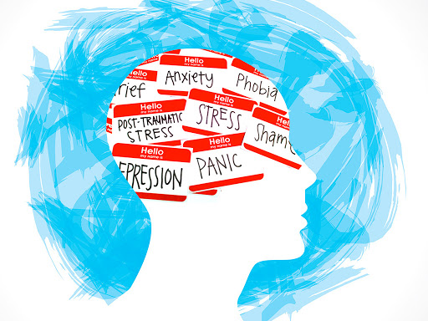
PSYCHOSOCIAL PEER MEDIATION
Psychosocial peer mediation is a unique approach which combines mental health literacy with intercultural dialogue work and specialised peer mediation training in an effort to address the multifaceted requirements of migrants.
Participants are therefore given the tools they need to develop their problem-solving abilities and deal with current psychological difficulties, increasing the likelihood of long-term conflict prevention and peacebuilding in migrant communities.
Mental health literacy education, which exposes participants to the manifestation of psychological trauma and common conditions like PTSD, anxiety disorders, depression and suicide, somatoform disorders, substance abuse, and addiction, is an essential part of these three elements. Participants also learn the value of psychosocial support.
With the ultimate objective of implementing locally sustainable conflict management systems, migrant-led peer mediation clinics are formed.
By developing internal conflict management skills, it emphasises the significance of specific cultural and contextual variables in conflict, which are frequently best addressed and sustainably resolved by the community members themselves.

Slide 12



PSYCHOSOCIAL PEER MEDIATION
Three interactive training pillars that cumulatively build upon one another make up the psychosocial peer mediation process. They are as follows:
Story Sharing - A technique for promoting cross-cultural dialogue on contentious issues including racism, prejudice, and traumatic experiences. In a setting where participants can trust one another, participants learn to be more honest with one another and lessen prejudices through sharing their own stories and experiences.
Participants in conflict competence training are given techniques for addressing conflict constructively and avoiding escalation. Moreover, prevalent context-specific causes of conflict are examined, including intercultural misunderstandings and stressful circumstances.
Peer mediation training provides participants with basic mediation skills, introduces the mediation process and principles, and uses role-playing-based simulations to handle common daily conflict situations in migrant communities.

Slide 13
MULTICULTURAL FAMILY MEDIATION
Working with individuals from many cultures is a part of family mediation. While working with clients from different backgrounds, mediators must become innovative and knowledgeable about various cultures.
Family mediators must initially think that cultural variation within cultures is just as significant as diversity between cultures. Stereotyping is one of the risks associated with failing to acknowledge the distinctions that actually exist across other cultures. Family mediators must treat their clients as distinct persons within their own cultural group while working with them.
According to the theory of cultural relativism, there are many perspectives on and interpretations of events.
No world view is greater, better, or more accurate than another, according to this criteria; they are only different. It is crucial for family mediators to adhere to this specific value assumption. Family mediators will be in a better position to learn about other cultures and exercise creativity in their work with clients from various backgrounds if they comprehend and embrace the idea of cultural relativism.

Slide 14
MULTICULTURAL FAMILY MEDIATION
In a study conducted by Barksy et al. (1996) participants said that the woman had little voice in the typical Pakistani Islamic home. The wife's job was to assist the husband while he spoke on behalf of the family. The conventional Canadian or American form of mediation between spouses would not be suitable in this circumstance.
The spouse would be in complete control, maybe going so far as to continue whatever abuse that already occurred in the household. Because of the conflicting perspectives within the Pakistani community and our own prejudices, this is a challenging subject to discuss.
According to one viewpoint in the Pakistani society (supported by some men and women alike), the roles of men and women are rigidly prescribed by religious law and must be observed. It would be disrespectful to their faith and right to self-determination for a mediator to attempt to establish a new power dynamic or reinterpret their positions.
Some in the Pakistani society think that this supposedly traditional view of roles is oppressive or even violent towards women. For instance, many think that giving women the same voice and rights as men is in line with their faith.

Slide 15
IMPORTANCE OF FAMILY WITHIN CULTURE
Multicultural family mediators see the topic of "who is family" to be important in a variety of ways. The challenges that a family is facing and the options that the family will pursue are reflected in how a client sees his or her family—in the past, in the present, and in aspirations for the future.
As an illustration, a parent could long for the societal ideal or experience intense humiliation for not achieving it. If so, the parents could be more sensitive to queries or mediation techniques that seem to be directed at them.
The mediator will also select who to include in the mediation process based on the clients' definition of "family."

Slide 16
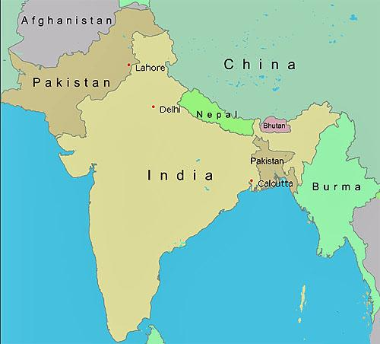
SOUTH ASIAN FAMILY UNITS
For example in traditional Pakistani households, the entire family, including the grandparents and cousins, holds a significant amount of value.
This implies that family members look out for one another and that those who have difficulties can frequently get assistance from other family members.
Often times, family members may tolerate wife abuse, alcoholism, or child abuse in the sake of maintaining family harmony.
Families may often try to handle these problems as a private family concern and prioritise maintaining a healthy marriage above preventing abuse.

Slide 17
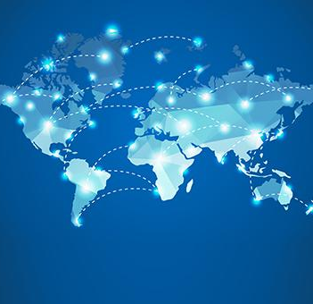
CROSS - BORDER FAMILY MEDIATION
Cross-border family mediation is a procedure run by one (or more) mediators who are neutral, skilled third parties. While the mediator cannot make decisions, they can assist the parties in reinstating dialogue and finding a solution to their dispute on their own.
Their customised agreement assures that, if a child is involved, their parenting decisions will take the child's best interests into consideration.
Family-related issues include : parental responsibilities and access rights, child abduction, child protection measures, support for children or former partners, and other effects of divorce or separation.

Slide 18
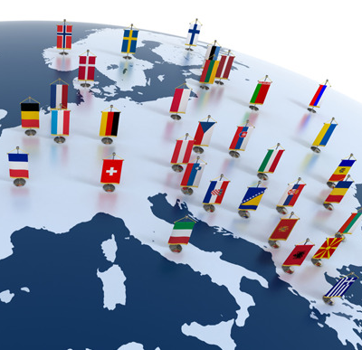
CROSS – BORDER FAMILY MEDIATION
An epidemic of parental kidnapping is being caused by the growing conflict between families fighting child custody issues across international borders.
Through cross-border family mediation initiatives, governments and international organisations continue to strive towards the development of practical solutions.
An issue that frequently generates ethical conundrums that may go overlooked, underestimated, or disregarded is making sure that a voluntary procedure does not culturally alienate or marginalise people.
Inequity is produced when a person is ostracised or denied their rights throughout any alternative conflict resolution procedure due to cultural constraints.

Slide 19



CROSS – BORDER FAMILY MEDIATOR TIPS
The mediators should be mindful of the unique cultural representations of the parties' parental rights, roles, and obligations.
Do not use coercion to compel one or both parties to the mediator's parental model beliefs
Any mediation participant's actions that suggest or involve abuse, neglect, threats, insults, or violence should not be permitted.
Environmental dangers and/or interactions with people who have a history of violence are part of the safety and security of cross-border mediators. Cases with a history of violence, mental instability, or drug misuse might not be suitable for mediation therefore, it is always important to have a risk assessment in place.

Slide 20

MULTICULTURAL WORKPLACE MEDIATION
Multicultural workplace mediation is method for resolving conflict or problems at work which arise due to cultural differences within the workplace.
Diversity and Equality Mediation focuses on challenges related to equality and diversity between a service provider and a consumer of that service, or within a business or community organisation.
According to studies, organisations with greater degrees of diversity perform better. Their staff members feel more valued, have more opportunities to unlock their full potential, and receive recognition.
According to McKinsey research, companies “in the bottom quartile both for gender and for ethnicity and race are statistically less likely to achieve above-average financial returns”
Source: https://www.mckinsey.com/business-functions/organization/our-insights/delivering-through-diversity

Slide 21
MULTICULTURAL
WORKPLACE MEDIATION
As long as everyone concerned agrees to it and formal proceedings are put on hold within the organisation, mediation can be used at any time throughout a dispute.
In general, mediation works best when a problem first occurs since the longer a dispute persists, the more likely it is that people's relationships will end or they will file formal complaints. After official dispute proceedings, however, the process can also assist you in mending broken relationships.
Conflicts between co-workers with various degrees of seniority or within the same team can be resolved through mediation. It can be especially helpful when interpersonal communication has broken down.

Slide 22
MULTICULTURAL
WORKPLACE MEDIATION
At most workplaces, people come from a wide variety of backgrounds. The larger the organisation, the more likely that there are employees of different races, ethnicities, religions, nationalities, cultural backgrounds and sexual orientation.
Organisations will have employees of different age groups, people of widely different socioeconomic backgrounds and people dealing with disability. People who have had such diverse life experiences can learn a lot from each other in a company that emphasises diversity and inclusivity within the workplace.

Slide 23
MULTICULTURAL
WORKPLACE MEDIATION
Every employee deserves to be treated with respect and tolerance at work. It may be the goal of a company to foster a culture that values diversity and inclusion, but this is not always simple to achieve.
Conflict can arise when people who have had very diverse life experiences find it difficult to communicate with or respect one another.

Slide 24
MULTICULTURAL
WORKPLACE MEDIATION
Multicultural mediation within a workplace is not always the suitable course of action. Incidents of bullying, harassment, discrimination and racism can have serious consequences for those responsible, such as official warnings, dismissal, or even criminal proceedings.
The alleged victim can feel too vulnerable to fully participate in the mediation process.
In these situations, you'll need to follow a formal procedure, and should get advice from your HR department.

Slide 25




MULTICULTURAL
WORKPLACE MEDIATION: GENERATIONAL GAPS
A varied team consists of individuals from all generations and age groups. Different ages may have different priorities or views, which can cause disagreement or make communication challenging.
On the basis of age, people occasionally criticise one another. While younger employees could think elderly workers should retire and make room for others, older workers can think younger workers have an entitlement mentality.
Conflict in the workplace can arise for a variety of reasons, but managers must discover the root cause of any dispute to see whether it may be connected to difficulties with inclusion and diversity.
Staff can better understand the many backgrounds and life experiences of those who work for the organisation by receiving regular diversity training that emphasises the value of respect and acceptance of others.

Slide 26

MULTICULTURAL WORKPLACE MEDIATION
In the workplace, it is never acceptable for someone to be hostile towards or cause conflict with those who are different from them because of their race or ethnicity.
Ethnic and cultural conflict isn't often immediately apparent. Those with concealed prejudice, which are unaware unfavourable views, are more likely to experience this situation.
Staff members' interactions with others may be impacted by unconscious prejudice even when they aren't aware of it. Due to ingrained prejudice towards working with individuals who are different from themselves, some people may find it difficult to get along with others.

Slide 27
HOW TO PROMOTE
AN INCLUSIVE WORKPLACE
Provide opportunities for group discussions so that staff may interact and converse
Create safe spaces
Ensure sure the office is accessible to those with disabilities or temporary mobility issues
Invite staff to provide suggestions for enhancing workplace inclusion
Employers should select candidates for new hires based on skills rather than disqualifying applicants due to factors like age, race, sexual orientation, etc.
Recruiting a diverse workforce is only the start. People must feel at safe and secure at work after they have been employed.

Slide 28
BIBLIOGRAPHY
Winter, H. M. E., Klapprott, F., Naanaa, M., Turk, A. M., & Winter, S. F. (2022). Psychosocial peer mediation as sustainable method for conflict prevention and management among refugee communities in Germany. Conflict Resolution Quarterly, 39(3), 195–210.
Duryea, M. L., and Grundison,J. B. Conflict and Culture: Research in Five Communities in Vancouver, British Columbia. Victoria, B.C.: Institute for Dispute Resolution,University of Victoria, 1993.
Kavanaugh, K. H.,and Kennedy, P. H. Promoting Cultural Diversity. Thousand Oaks, Calif.: Sage, 1992.
Dabbagh, M. Cultural influences in Family Conflict: Family Mediation in a Multicultural Context, 2013
Allan Barsky, David Este and Don Collins. Cultural Competence in Family Mediation , Mediation Quarterly, Spring 1996
https://www.caos-conflict-management.co.uk/equality-and-diversity-mediation.html
https://pollackpeacebuilding.com/blog/3-examples-of-diversity-conflict-in-the-workplace/
https://www.mindtools.com/aj565hn/resolving-workplace-conflict-through-mediation
https://restorativejustice.ie/peer-mediation-in-castlerea-prison/

