Slide 1

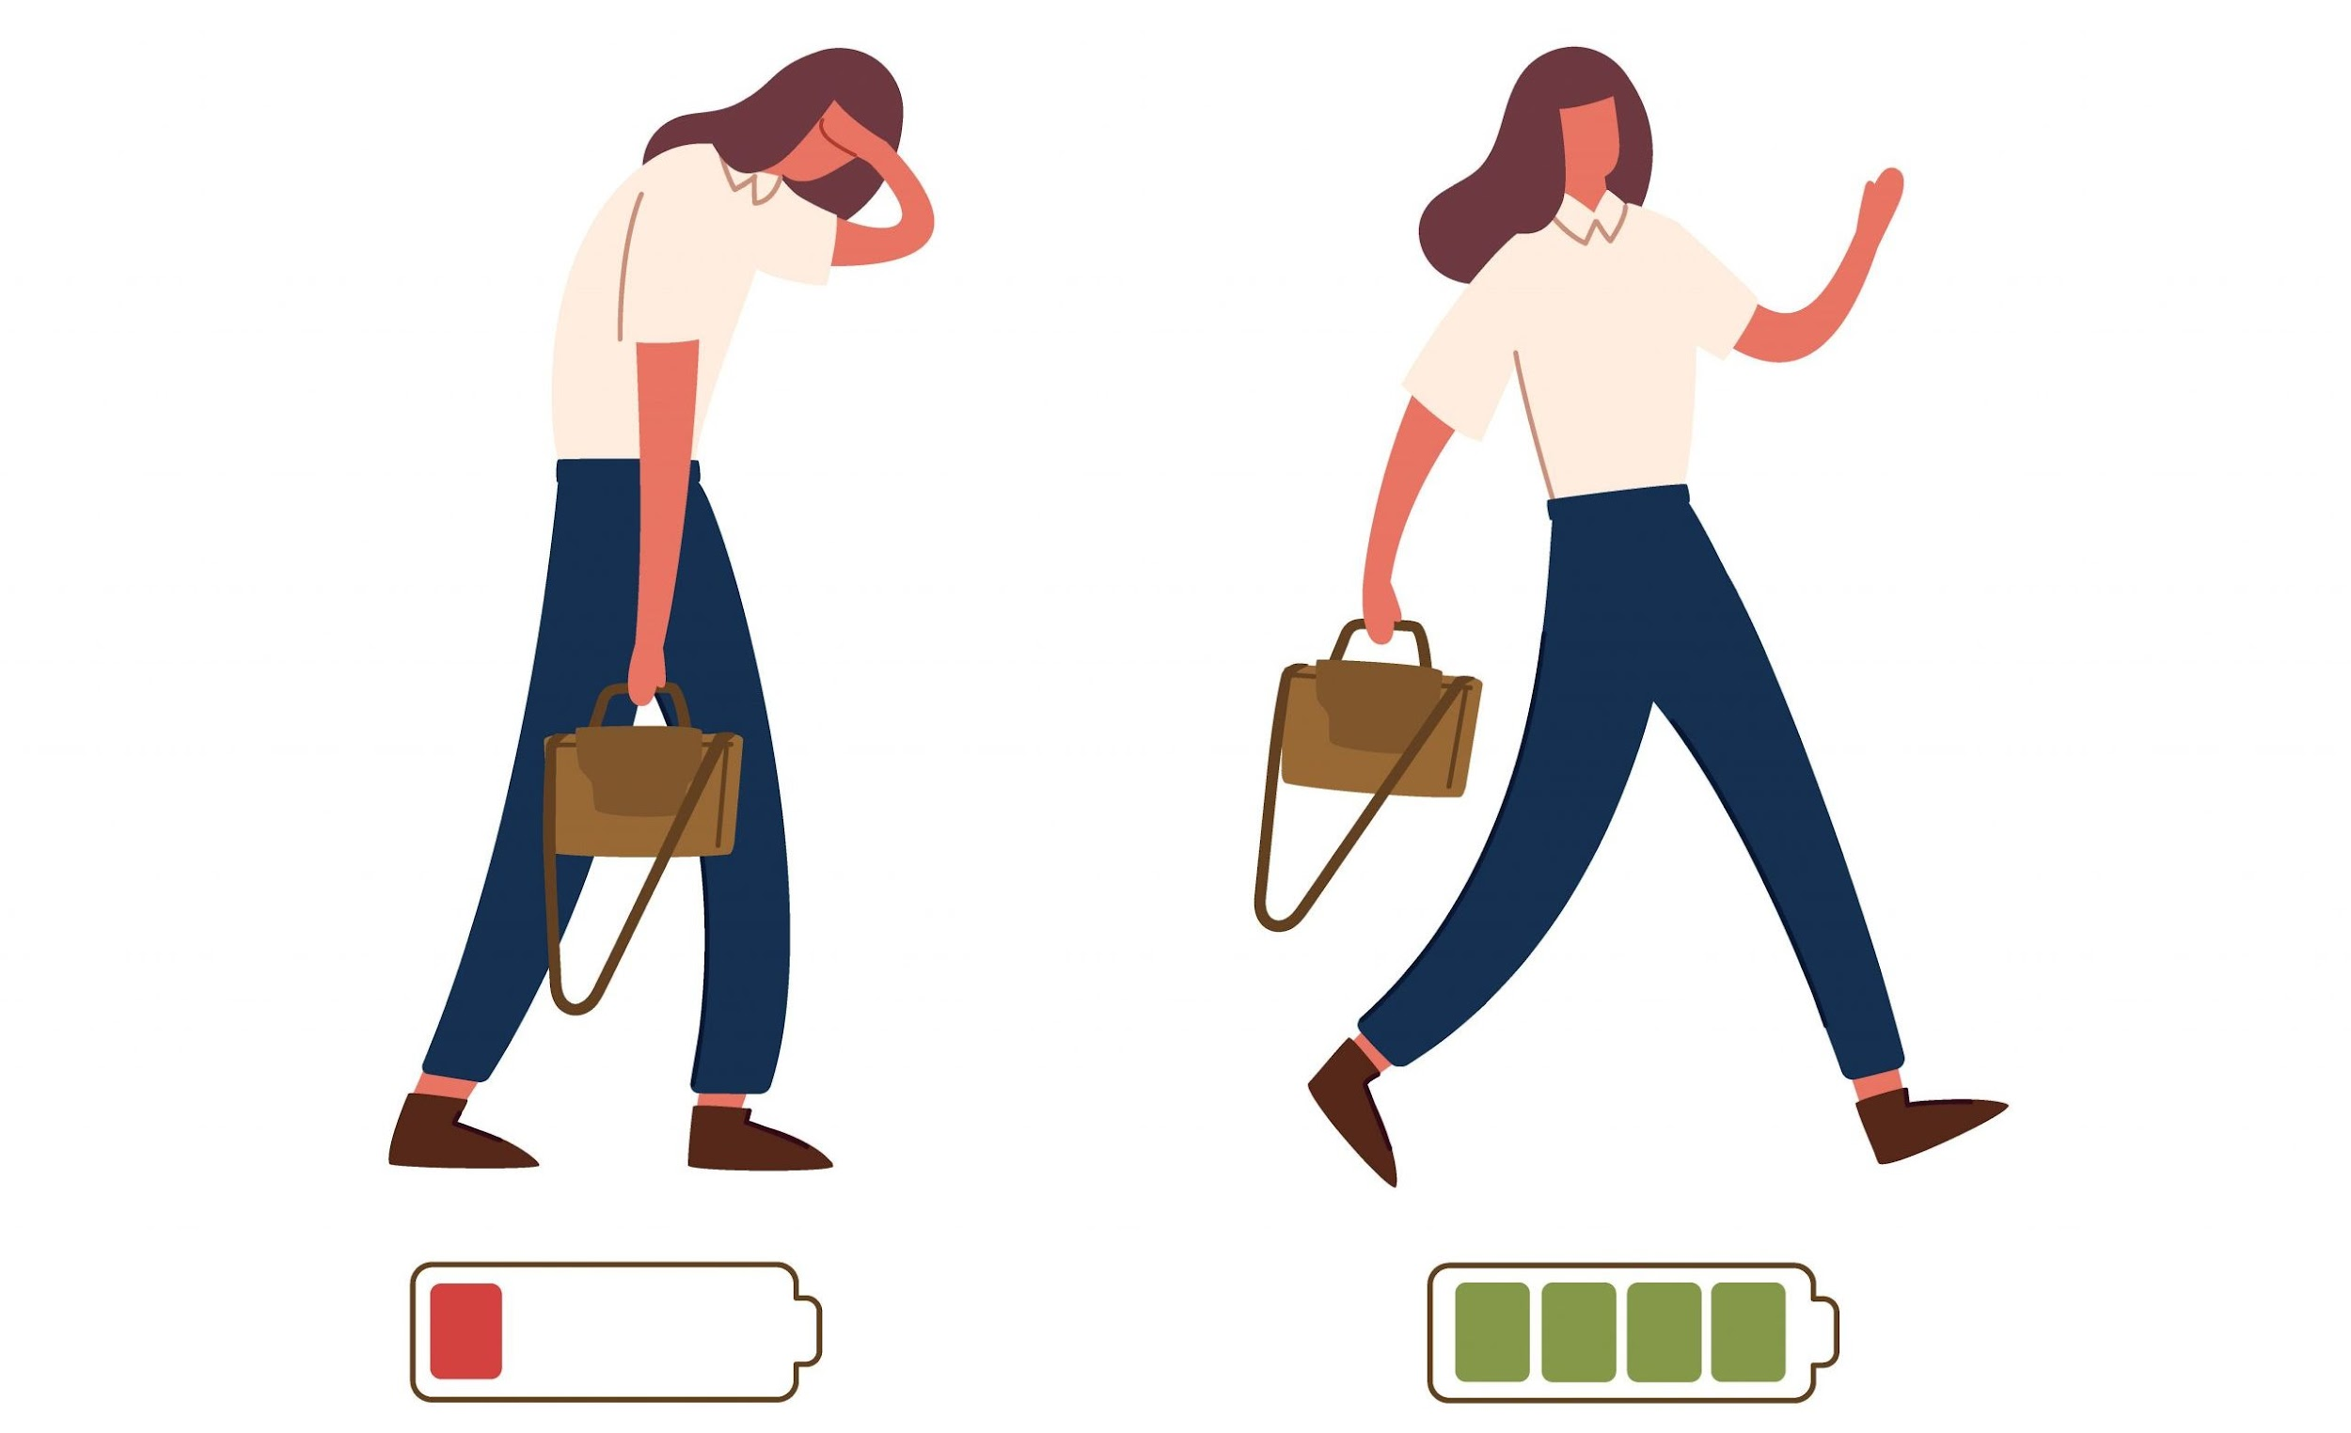

MENTAL HEALTH AND SELF CARE
IN THE WORK OF A MULTICULTURAL MEDIATOR

Slide 2
BURNOUT
Without compromising their objectivity, mediators must establish genuine relationships with parties, control their emotions without becoming emotionally attached, and support decision-making without diminishing autonomy.
Years of study on occupational stress, commonly referred to as "burnout," show that not only are mediators prone to burnout, but also that the symptoms of burnout weaken the core values of good mediation.
For instance, a burnt-out mediator may have limited and unimaginative thinking, a decreased ability to control emotions, poor decision-making, and concentration and memory difficulties.

Slide 3
BURNOUT
The potential for mediator burnout not only jeopardises the effectiveness of mediation but also exposes flaws in the legislative structure intended to provide mediation quality control.
Although there has been much discussion about how to make sure mediators provide high-quality services, the emphasis has been on training recently graduated mediators rather than those who are currently in the field. Moreover, the organisational frameworks in which mediators operate receive less consideration.

Slide 4

SIGNS OF BURNOUT
Burnout is a prevalent problem at work, and it gets worse when we take our job home. The likelihood of burnout has increased given how the boundaries between work hours and free time have been fuzzier in the work-from-home environment.
The good news is that burnout can be overcome by any of us if it is recognised and acknowledged early on. Burnout is sneaky, and each person will manifest and feel it differently. You may see other mental, physical, and emotional red flags such as:
Altered eating or sleeping patterns
Anxious feelings
Avoiding work-related activities and socialising
Easily aggravated by co-workers, close friends, and family
Reduced immunity and psychosomatic symptoms, such as nausea, migraines, and illness
Brain fog or forgetfulness

Slide 5
RECOGNISING TRIGGERS AT WORK
Do you feel content with the work you do? Having a clear sense of why you are doing anything is crucial, whether it is a short-term employment or a long-term professional path. Does your job/career match your values? Are your achievements being acknowledged? Being recognised and valued increases happiness in what you do and lowers the risk of burnout.
Burnout is also less likely to happen when there is a safe place where complaints may be expressed and equitably resolved without regard to office politics or favouritism. Are you able to advance in your position? Do you feel free to act independently? Having the impression that you are powerless can exacerbate anger and eventually result in burnout.
As mediators, we can examine our own feelings of pressure to reach agreements. What does your company's definition of a productive mediation look like? Do they place more significance on the quantity of settlements reached or do they place more emphasis on the effectiveness of mediation and the parties' comments?

Slide 6
COMPASSION FATIGUE
Compassion fatigue is the lack or diminished ability to experience and express true empathy, support, and understanding.
In research of burnout in the professions, the phrase "compassion fatigue" originally developed to characterise a reduction in compassion for patients or clients in need (Maslach, 2003). The phrase "secondary traumatic stress disorder" is used in academics.
It's thought that the phrase "compassion fatigue" is euphemistic. When used to analyse the behaviour of mass contributions in reaction to the media response to catastrophes, compassion weariness has sociological implications as well.

Slide 7
COMPASSION FATIGUE
When there is a strong and constant demand for compassion, exhaustion most frequently happens. This issue typically arises when stress levels are high, attention demands are increasing, and emotional reserves don't seem to be enough to meet everyone's requirements, including those of staff members as well as patients and their families.
Compassion fatigue is a disorder marked by mental and physical depletion that reduces one's capacity for empathy and compassion. It is sometimes referred to as the unfavourable side effect of caring. It is also known as secondary traumatic stress disorder.

Slide 8
COMPASSION FATIGUE
Several types of carers and occupations are impacted by compassion fatigue. Professionals who operate in a helpful or therapeutic position seem to experience it most frequently. You may be more susceptible to developing compassion fatigue if you work as a mediator, doctor, therapist, first responder, nurse, or other service provider of any type.
When these situations and triggers begin to have an impact on your thoughts, feelings, and general wellbeing outside of work, compassion fatigue sets in. It's common for carers to have work-related effects, but when those effects become too great, you may be suffering from compassion fatigue.
There are actions you may take to heal, even though the symptoms can be terrifying and even incapacitating. Identifying the symptoms, taking preventive action, and getting treatment can all be beneficial.

Slide 9
BURNOUT VS COMPASSION FATIGUE
A psychological condition known as burnout (or occupational burnout) describes a broad feeling of exhaustion and a lack of interest in or drive for one's work.
Secondary trauma and compassion fatigue are two terms used to describe the unfavourable feelings that people experience after helping others as part of their work.

Slide 10
BURNOUT VS COMPASSION FATIGUE
There are four key distinctions between burnout and compassion fatigue:
Exposure to traumatic content is the source of compassion fatigue. Work-related factors including the position, co-workers, boss, and a toxic workplace culture contribute to burnout.
Compassion fatigue has a rapid onset and can be felt after the first experience of absorbing one’s traumatic material.
The result of helping others is referred to as compassion fatigue. The phrase "burnout" refers to the effects of a demanding work environment.
If treated early, compassion fatigue can be solved more quickly than burnout. Recovery from burnout takes more time.

Slide 11
SIGNS OF COMPASSION FATIGUE
Your capacity to perform your everyday tasks or job might be momentarily affected by compassion fatigue. There are symptoms that you could be experiencing compassion fatigue, as well as those of someone you know or work with.
According to research, long-term stress can cause mild to severe mood fluctuations, especially as you become older. Common symptoms of compassion fatigue brought on by too much stress include:
Abrupt changes in attitude and mood
Changing one's outlook to one that is cynical
Being very irritated or easily angered

Slide 12
SIGNS OF COMPASSION FATIGUE
Experiencing detachment - A drastic disengagement from social ties is a frequent symptom of compassion fatigue. Friendships or connections may be neglected. Your personal or professional life may make you feel emotionally cut off from other people or numb.
Addiction - There is a connection between addiction or covert self-medication and compassion fatigue. Alcoholism, gambling addiction, drug addiction, and even workaholism can be a sign of compassion fatigue and a way of coping with it.

Slide 13
SIGNS OF COMPASSION FATIGUE
Common reactions to stressful or traumatic events include anxious or sad feelings and anxious behaviours.
You may have anxiety about the world around you as a result of compassion fatigue, either perceiving it as hazardous or being overly concerned with your own and your family's safety.
You can also experience depression as a result. You can experience discouragement or wonder if you're a productive employee.

Slide 14
SIGNS OF COMPASSION FATIGUE
Productivity at work - According to studies, compassion fatigue-related stress can have an impact on both your mind and body. You could have problems focusing or working efficiently in your personal or professional life.
Stress over a long period of time might impair your memory and make it harder to focus on your task.
Insomnia - Being plagued by distressing pictures that may interfere with your thoughts or dreams can cause you trouble with falling or staying asleep.

Slide 15





PHYSICAL SIGNS OF COMPASSION FATIGUE
Many physical symptoms might result from compassion fatigue. They consist of:
EXHAUSTION
HEADACHES
DIGESTIVE PROBLEMS
CHANGES IN APETITE
MIGRAINES

Slide 16
WHAT DO YOU DO FOR YOURSELF ?
We frequently tend to overlook our own needs when juggling several jobs and helping others with their own issues. Even though self-care is essential to our productivity, it is often taken for granted.
In order to be our best selves in the work of a multicultural mediator we need to look after ourselves. Do you practise self-care every day or every night? Are we usually ordering greasy takeout from a restaurant rather than preparing healthy, meals? Do you engage in any spiritual or religious activities? Do you give your time to charities or doing something for others?
Helping others benefits you because it shifts your attention from being selfish to being appreciative and kind.

Slide 17
SELF CARE
Compassion fatigue frequently has both physical and emotional exhaustion as a component. Making time for self-care may be a powerful solution for many. Some forms of self-care are:
Planning a healthy meal
Drinking water
Getting enough sleep
Exercising
Meditation
Getting a relaxing massage

Slide 18
SELF CARE
We've all heard the phrase "Prevention is better than cure" a million times. Your life is valuable and deserves to be lived. You can think about incorporating the following suggestions into your everyday routine:
Find a moment to meditate each day before you turn on your phone.
Keep a gratitude journal
Spend time interacting with your favourite friends and family members.
Spend time alone, doing what you enjoy the most.
Set aside time for the things you do outside of work.
Workout, even if just for a short while.
Take pauses from using your technological devices.
Take annual leave and reset.

Slide 19
HOW TO SUPPORT THE CLIENT
AND THEIR MENTAL HEALTH
Meet privately with clients to listen to their perspective and understand their viewpoint
Describe the mediation process clearly in advance
Discuss any adjustments which might help the clients access the mediation in a way that feels safe and supported
Structure a mediation across two shorter meetings instead of one longer meeting
Work with the parties to agree guidelines on communication and behaviour in the joint meeting, so that everyone knows their voice will be heard and valued
Take regular breaks in joint and private meetings

Slide 20
MENTAL HEALTH IN ORGANISATIONS
Nowadays, 1 in 6 workers are struggling with a mental health issue like stress, sadness, or anxiety. This may prevent individuals from doing their best work.
When employees are fit, inspired, and concentrated, organisations operate more effectively. Good companies help their workers manage and recover when they are dealing with mental health issues. How well and how fast an employee may return to peak performance depends on the help they get from their company.
It's important to support employees when they are dealing with mental health issues not just to retain a great employee on board, but also to demonstrate the values of your company. Every employee needs to know that their company upholds its principles and values its workers. Organizations that assist staff benefit in terms of employee loyalty and commitment since trust and integrity are major engagement drivers.

Slide 21
HOW TO SUPPORT STAFF
AND THEIR MENTAL HEALTH
For someone with seasonal depression, a light box or a seat with more natural light
Return to work regulations for instance, a phased return with progressively increased hours.
Introducing an allowance for mental health days off
Alterations to the job itself (temporary or permanent)
Reassigning some work or altering people's responsibilities and job descriptions
Relocation to a more suited position

Slide 22
HOW TO CREATE A CULTURE OF SUPPORT
IN AN ORGANISATION
Organisations need to send a clear signal to staff that their mental health matters and being open about it will lead to support, not discrimination. A simple way to communicate this is to explain that mental health will be treated in the same way as physical health.
Organisations can back this commitment up with a clear mental health strategy and specific policies to ensure employees experiencing mental health problems get the support they need straight away
Managers need to be approachable and confident about mental health and should take steps to normalise conversations about mental health and encourage open dialogue.
Regular one-to-one meetings and catch- ups are a great place to ask your staff how they’re getting on and doing so regularly will help build trust and give employees a chance to raise problems at an early stage.

Slide 23
HOW TO CREATE A CULTURE OF SUPPORT
IN AN ORGANISATION
Adjustments for mental health are typically easy, realistic, and affordable. This is not a comprehensive list; managers should speak with each employee about their unique demands and use their creativity to come up with solutions.
Alterations to how people carry their their roles
Hours that can be changed, or a new start/finish time. It can also be beneficial for shift employees not to work evenings or to divide their days off to break up the workweek.
Changing the workplace to make it more or less crowded, calmer, or with separating screens
Working from home
Adjustments for breaks
Offering of quiet spaces
Having a prayer room

Slide 24
HOW TO SUPPORT STAFF
AND THEIR MENTAL HEALTH
Assistance with application preparation for positions and secondments in other departments.
Offer more guidance or assistance from the management on how to manage work load.
More instruction, guidance, or mentorship
More assistance managing and negotiating the task
More encouraging and helpful feedback
Debriefings following challenging conversations, clients, or jobs
Buddy or mentor systems (formal or informal)

Slide 25
SELF REFLECTION
Self reflection can be defined as "a mental process that, applied to the act of learning, requires learners to use critical thinking to scrutinise supplied material, question its accuracy, and develop conclusions based on the emerging ideas"
Tools for self-reflection can include :
Case learning log, which needs to be finished after each session.
Mentor supervision report, which a mentor or colleague should fill on a regular basis.
Notes you have taken during or after the session
Any voice recordings you may have done yourself post session to reflect on the things you have done or could improve

Slide 26
SELF REFLECTION
Self reflection is an effective and useful technique that asks learners to reflect on their goals, experiences, abilities, and learning. The long-term value of freshly acquired abilities is greatest for those who reflect on them. It entails posing the following queries: What were the situation's advantages and disadvantages?
What did I discover?
What failed, and why?
How does this experience compare to previous circumstances I've encountered?
What would I change if I had a second chance?
Why and how did it work?
How can I apply this knowledge?
What can I take away from that experience?

Slide 27




SELF REFLECTION
Prior to each mediation, spend five minutes reflecting on the past session's events and your strategy for the current one. Even at five or ten minutes past the hour, you can begin the mediation by explaining to the parties that you need time to organise your thoughts and that they will be paid for that time.
Spend some time at the conclusion of each session. It could be beneficial to write a checklist of questions for yourself.
After each mediation session, provide a memo to the clients outlining what was discussed and what was provisionally agreed upon.
After each meditation, tape record your ideas, or you might write them down or type them. We cannot retain all the knowledge in our heads. You may make sense of the numerous things happening throughout the meditation by writing down your ideas. That seems to me like a superhighway. There are several walkways and roads that cross at different levels. Without a map, it is difficult to keep track of all of them.

Slide 28
BIBLIOGRAPHY
https://www.webmd.com/mental-health/signs-compassion-fatigue
https://scholars.law.unlv.edu/cgi/viewcontent.cgi?article=2243&context=facpub
https://www.griefworkcenter.com/compassion-fatigue-vs-burnout/
https://mediate.com/battling-burnout-mental-health-and-self-care-in-mediation/
https://www.aswm.org.uk/post/supporting-mental-health-and-wellbeing-during-mediation
https://lisaarora.com/ways-to-stay-calm-cool-and-collected-on-mediation-day/
https://www.mind.org.uk/media-a/4661/resource4.pdf

